Slide 1
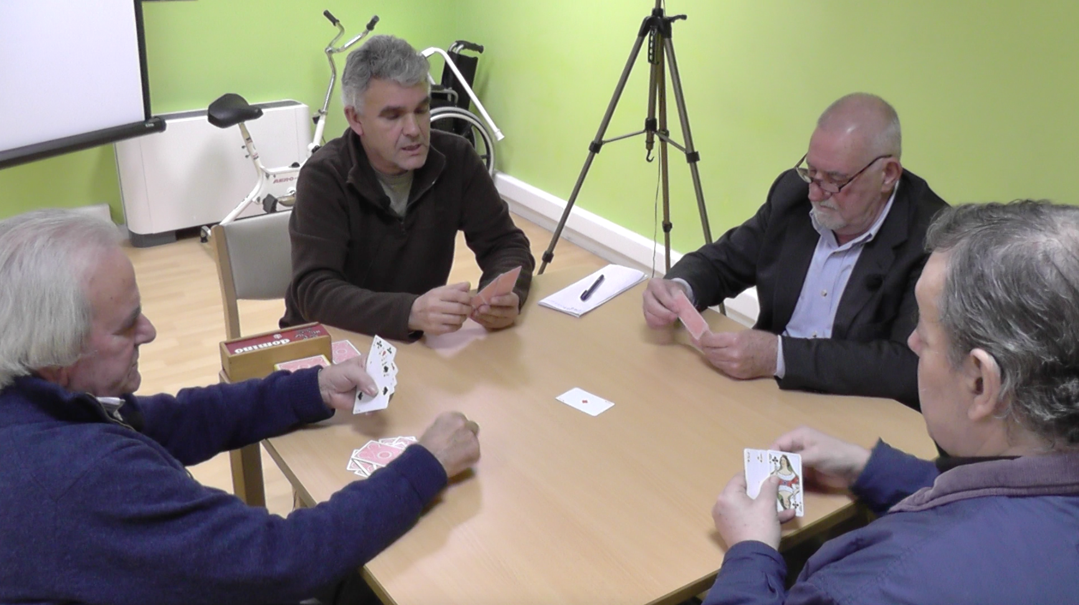
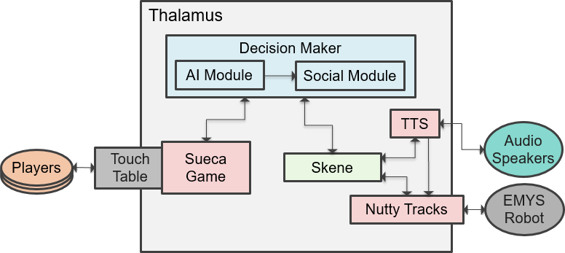
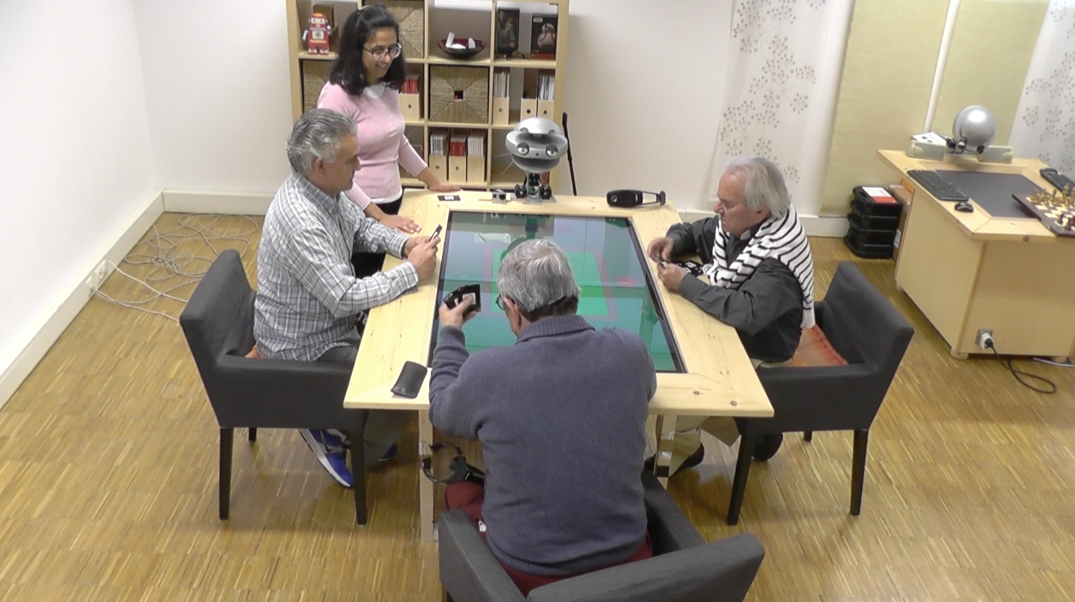





Social and Entertainment Robots for Older Adults
Filipa Correia, Patrícia Alves-Oliveira, Sofia Petisca, Ana Paiva
1
2
3
“We had a good time and lots of fun. We laughed a lot!”
Semi-structured interview:
“At the beginning was harder...”
1. experience of playing
“The table should be smaller”
2. the robotic game player
“It said what was going to play like I am going for an Ace now, we don’t do that”
Take-away messages:
▼They had difficulties in seeing the virtual cards of the robot
▲Funnier than the traditional game
The robot should do signals
“I trusted the robot more than if a person would count the points, people cheat more than machines.”
“Useful to train people [that do not know the game] in a fun and engaging way.”

